Slide 1
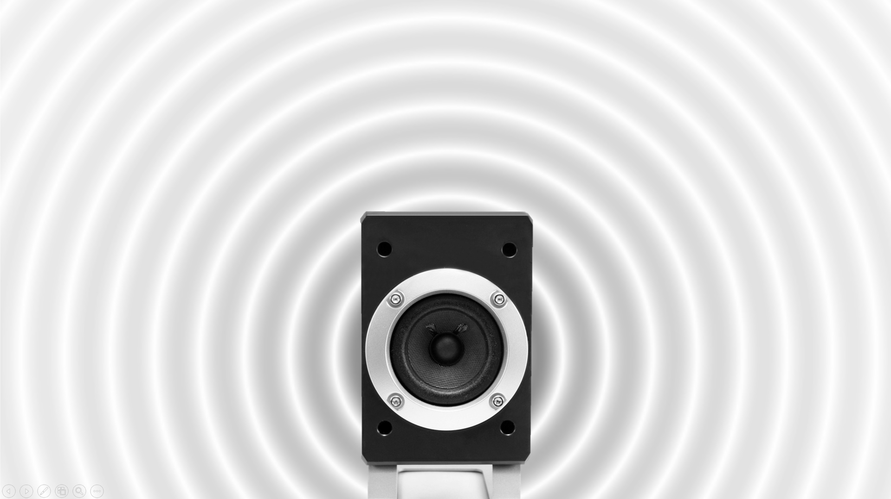
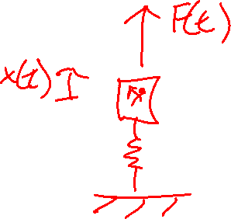
Sound sources
Nonlinear sources
Tyler Dare

Slide 2
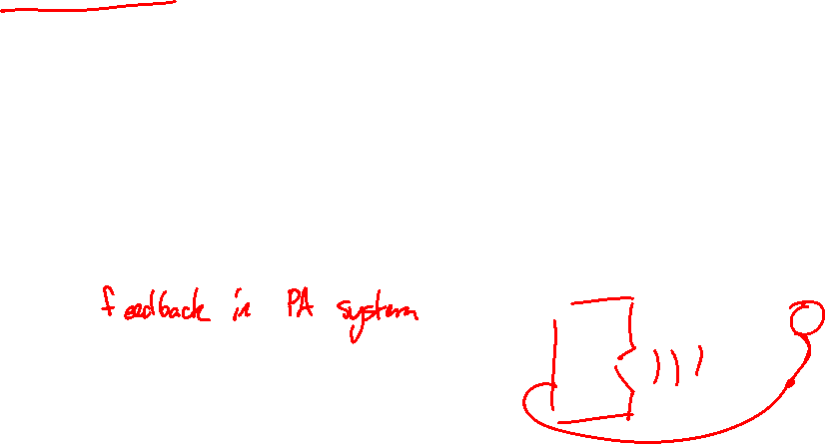
Nonlinear sources
Up to now, we assume the forcing function is independent of the response:
Piston’s motion does not depend on acoustic field
Force on mass does not depend on the mass’s motion
In some systems, the response affects the excitation and the excitation causes the response.
Microphone picks up the sound from a speaker, which amplifies the sound further, leading to feedback

Slide 3
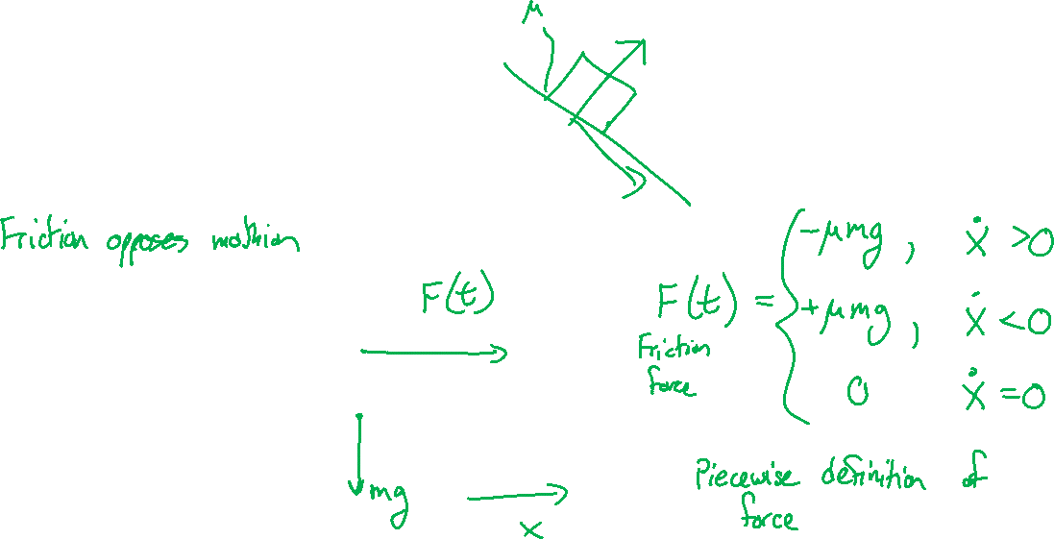
Friction-induced vibration
Friction force can vary with velocity.

Slide 4


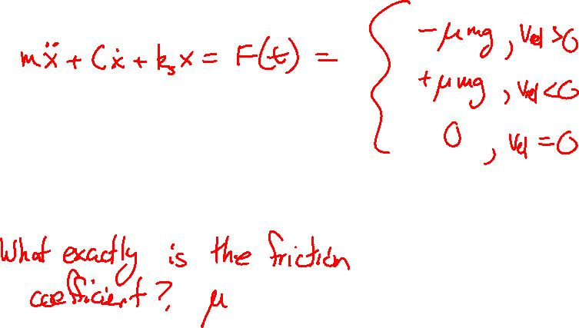




Friction-induced vibration
What is the behavior of a SDOF system excited by a friction force?
$$k_{s}$$
$$x\left(t\right)$$
$$m$$
$$C$$
$$μ$$
$$v_{belt}$$

Slide 5
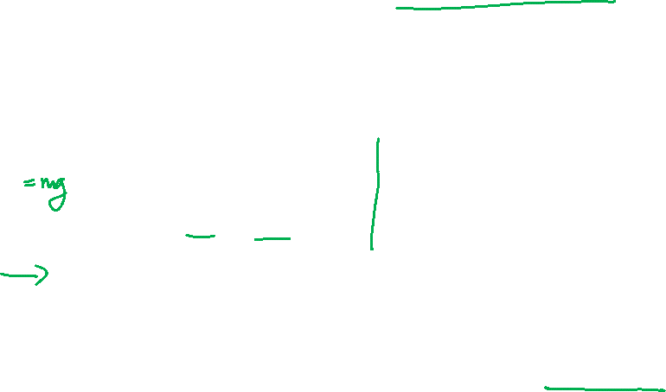






Friction-induced vibration
In general, the friction force is a function of the relative velocity between two surfaces.
$F_{friction}\left(t\right)=μ(v_{rel})N$
$$N$$
$$v_{rel}\left(t\right)={\dot{x}}_{1}\left(t\right)−{\dot{x}}_{2}(t)$$
$${\dot{x}}_{1}\left(t\right)$$
$${\dot{x}}_{2}(t)$$
$$N$$

Slide 6
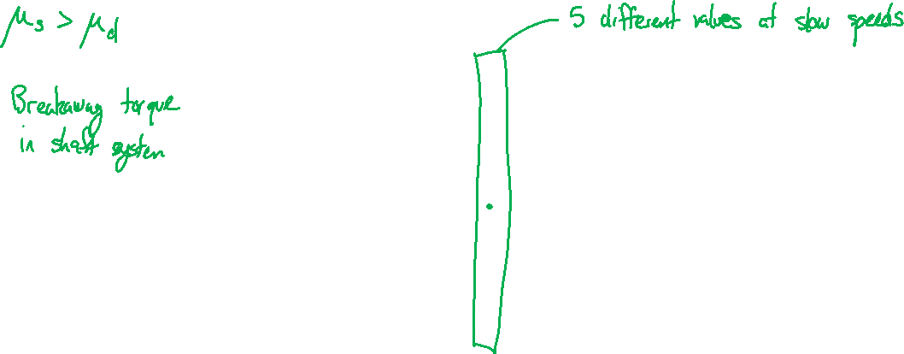
Friction-induced vibration
Static and dynamic friction coefficients can be significantly different.

Slide 7
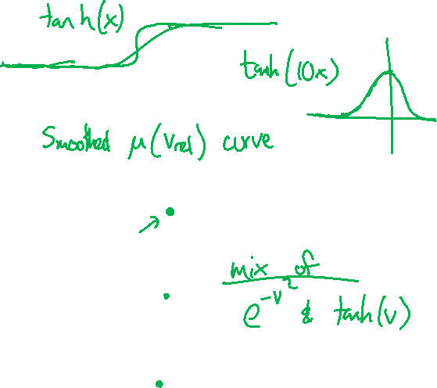
Friction-induced vibration
Modeling can be easier if we smooth the function out.

Slide 8

Friction-induced vibration
What is the behavior of a SDOF system excited by a friction force?
$$k_{s}$$
$$x\left(t\right)$$
$$m$$
$$C$$
$$μ$$
$$v_{belt}$$

Slide 9




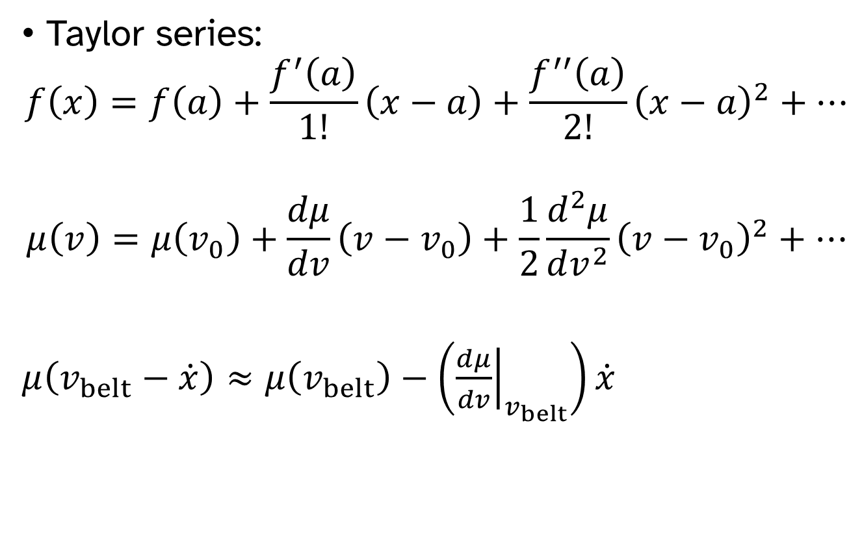


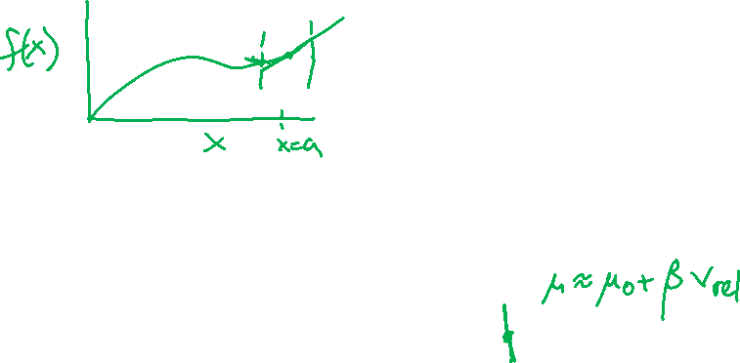
Friction-induced vibration
Taylor series:
$$f\left(x\right)=f\left(a\right)+\frac{f^{′}\left(a\right)}{1!}\left(x−a\right)+\frac{f^{′′}\left(a\right)}{2!}{\left(x−a\right)}^{2}+⋯$$
$$μ\left(v\right)=μ\left(v_{0}\right)+\frac{dμ}{dv}\left(v−v_{0}\right)+\frac{1}{2}\frac{d^{2}μ}{dv^{2}}{\left(v−v_{0}\right)}^{2}+⋯$$
$μ\left(v_{belt}−\dot{x}\right)≈μ\left(v_{belt}\right)−\left({\left.\frac{dμ}{dv}\right|}_{v_{belt}}\right)\dot{x}$
$$k_{s}$$
$$x\left(t\right)$$
$$m$$
$$C$$
$$μ$$
$$v_{belt}$$

Slide 10





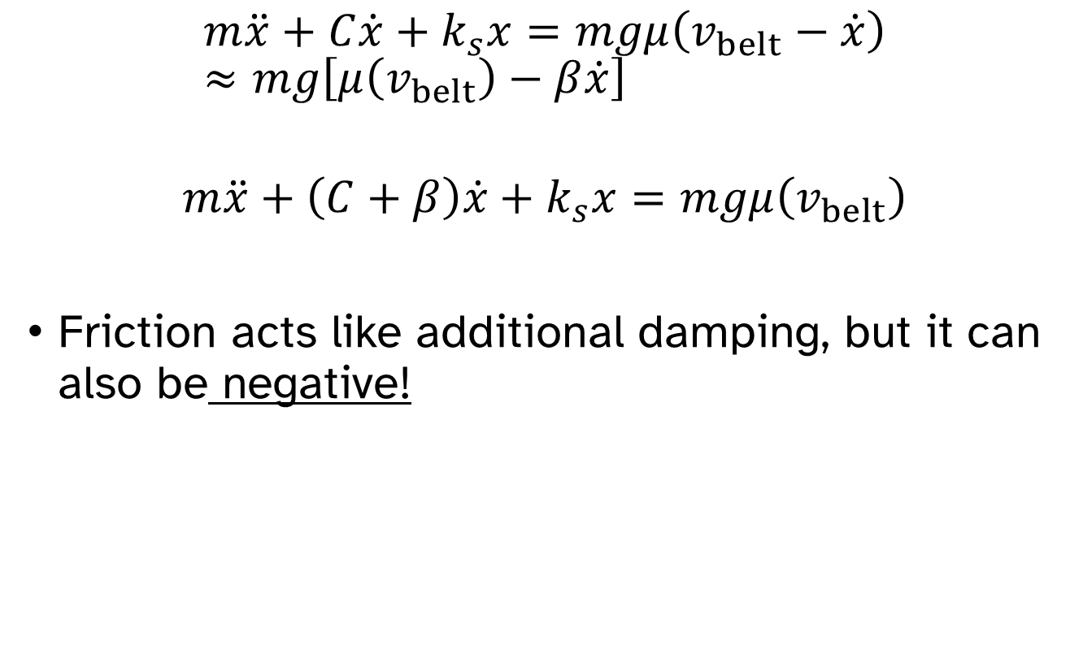

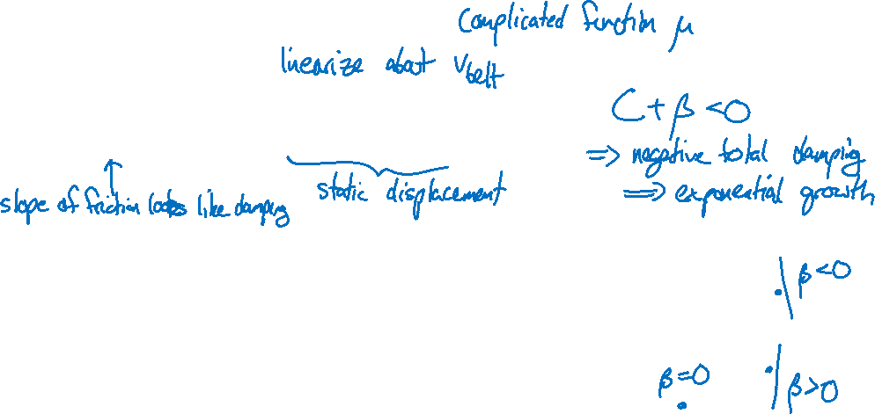
Friction-induced vibration
$$m\ddot{x}+C\dot{x}+k_{s}x=mgμ\left(v_{belt}−\dot{x}\right)≈mg\left[μ\left(v_{belt}\right)−β\dot{x}\right]$$
$$m\ddot{x}+\left(C+β\right)\dot{x}+k_{s}x=mgμ\left(v_{belt}\right)$$
Friction acts like additional damping, but it can also be negative!
$$k_{s}$$
$$x\left(t\right)$$
$$m$$
$$C$$
$$μ$$
$$v_{belt}$$

Slide 11
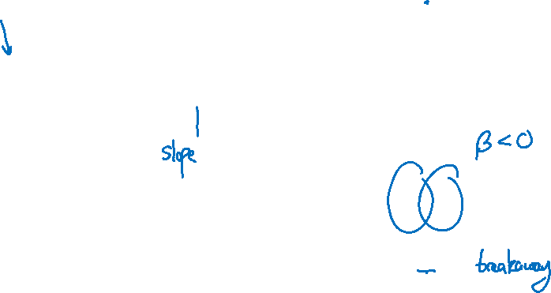
Friction-induced vibration
$$m\ddot{x}+\left(C+β\right)\dot{x}+k_{s}x=mgμ\left(v_{belt}\right)$$
$$k_{s}$$
$$x\left(t\right)$$
$$m$$
$$C$$
$$μ$$
$$v_{belt}$$

Slide 12
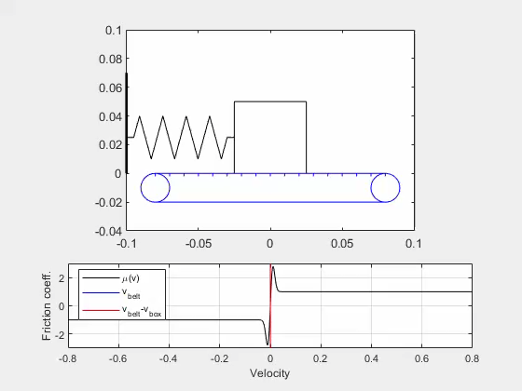
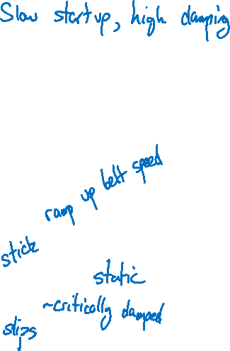
Friction-induced vibration

Slide 13
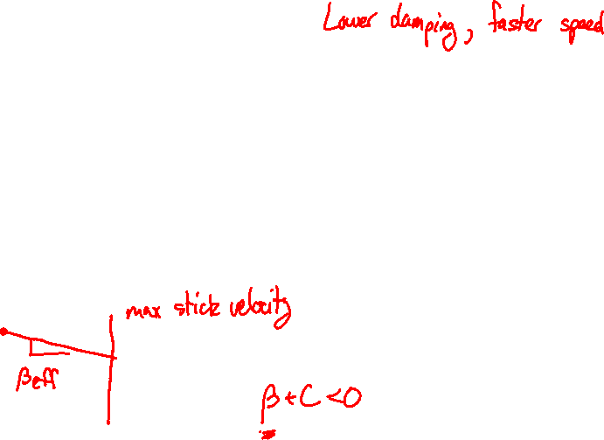
Friction-induced vibration

Slide 14
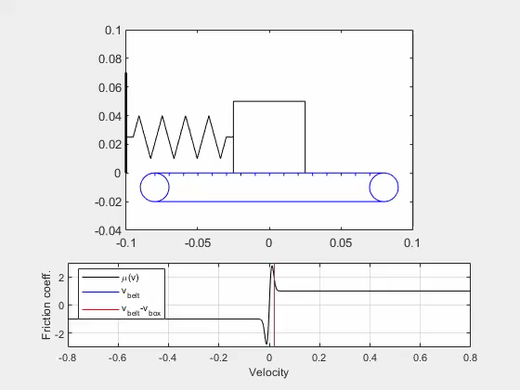
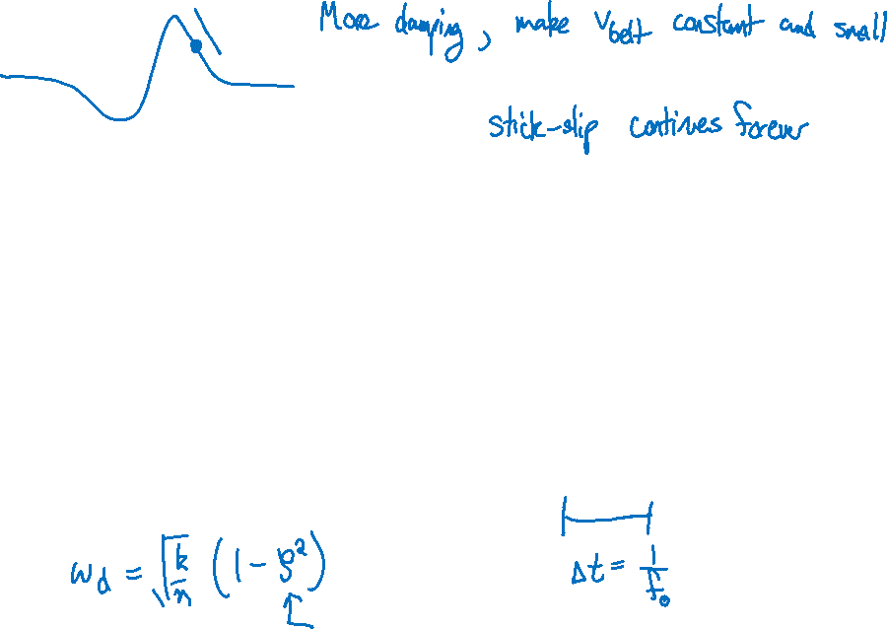
Friction-induced vibration

Slide 15



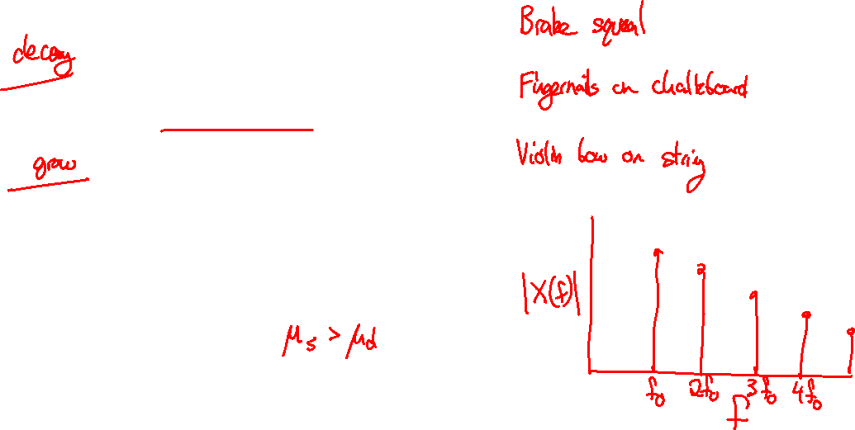



Friction-induced vibration
Vibrations grow if:
The system’s damping dissipates energy faster than friction adds it
Vibrations decay if:
Friction adds energy faster than the system can dissipate it
Stick-slip can occur when the friction is decreasing with increasing speed.
$$k_{s}$$
$$x\left(t\right)$$
$$m$$
$$C$$
$$μ$$
$$v_{belt}$$

Slide 16
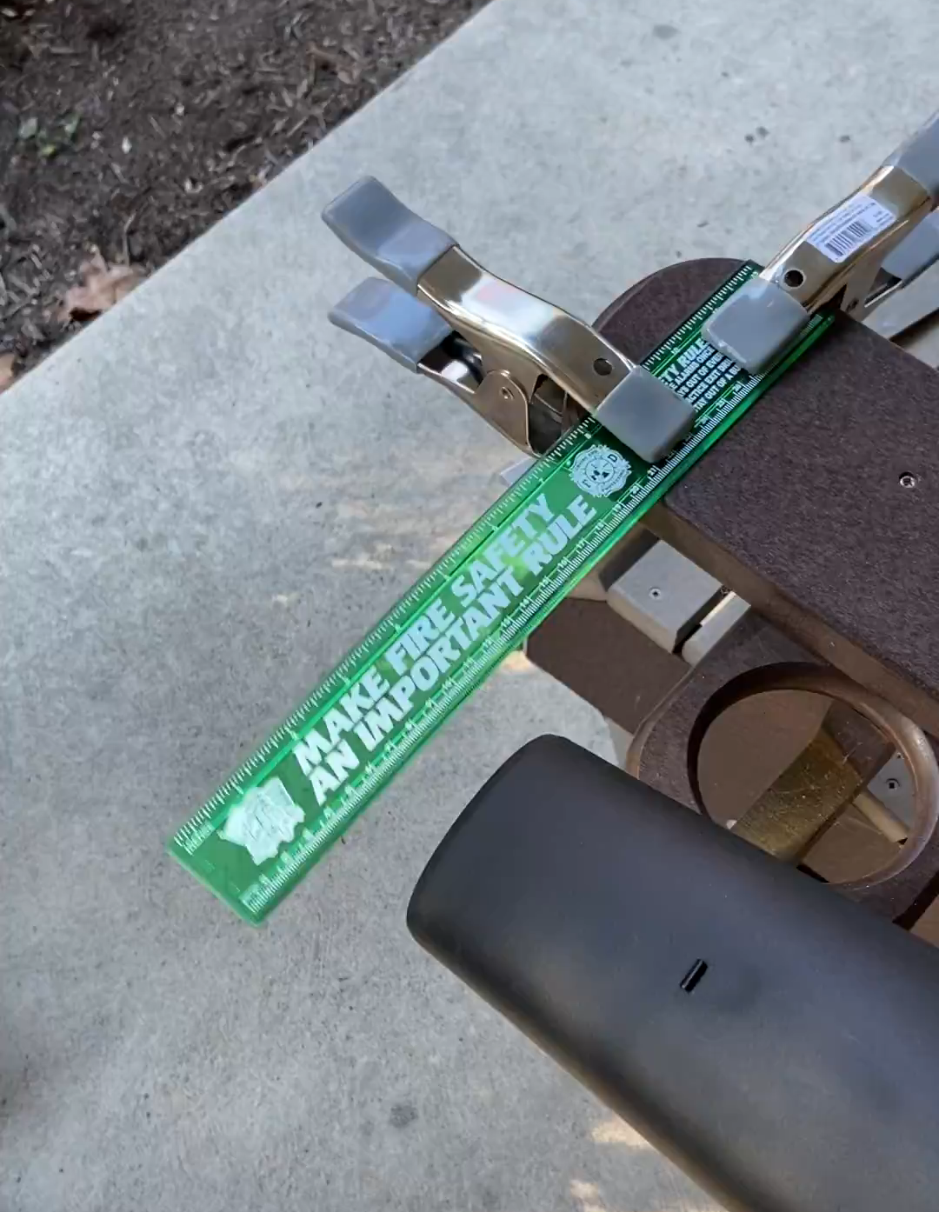
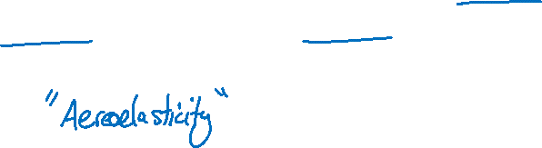
Vortex shedding and lock-in
Large oscillations can occur when flexible structures are excited by flow.

Slide 17
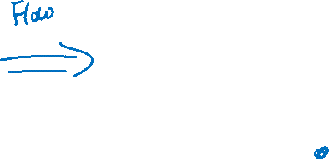
Vortex shedding
Oscillating vortices in flow behind an object.
Cesareo de La Rosa Siqueira

Slide 18
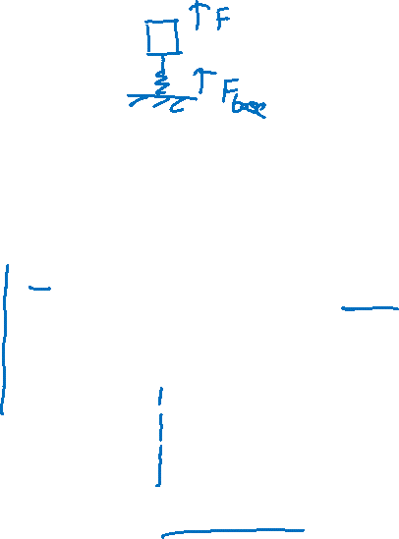
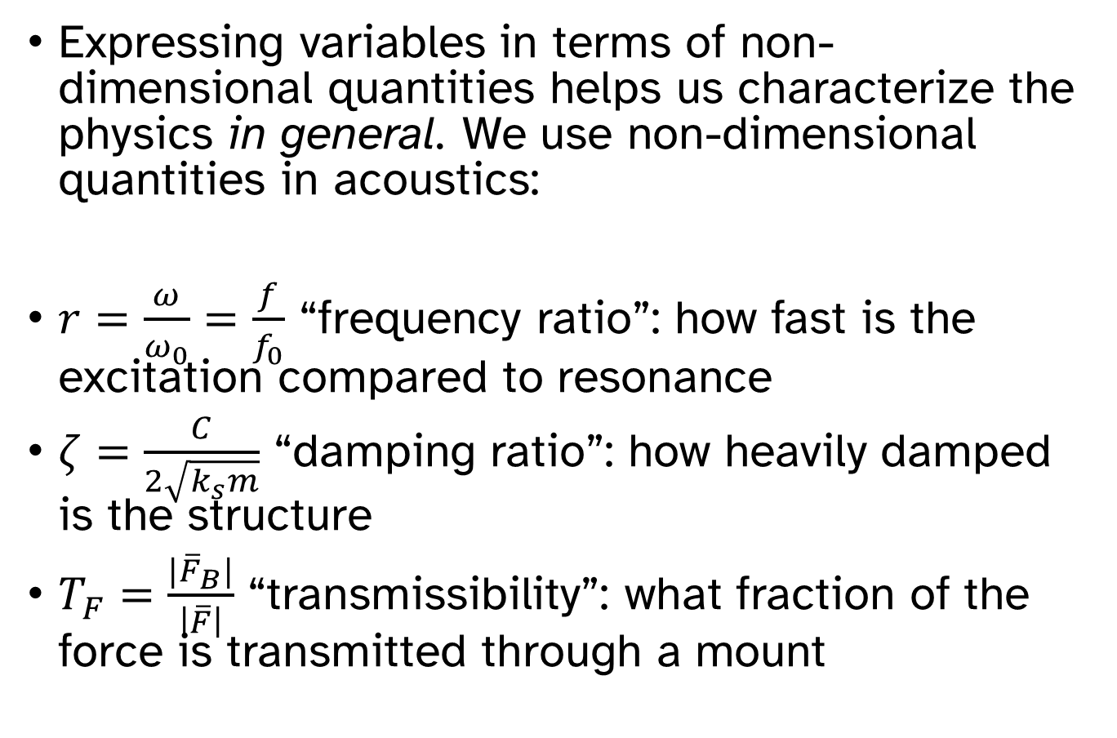
Non-dimensional quantities
Expressing variables in terms of non-dimensional quantities helps us characterize the physics in general. We use non-dimensional quantities in acoustics:
$r=\frac{ω}{ω_{0}}=\frac{f}{f_{0}}$ “frequency ratio”: how fast is the excitation compared to resonance
$ζ=\frac{C}{2\sqrt{k_{s}m}}$ “damping ratio”: how heavily damped is the structure
$T_{F}=\frac{{|\overline{F}}_{B}|}{\left|\overline{F}\right|}$ “transmissibility”: what fraction of the force is transmitted through a mount

Slide 19
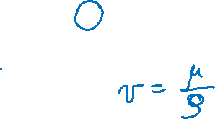
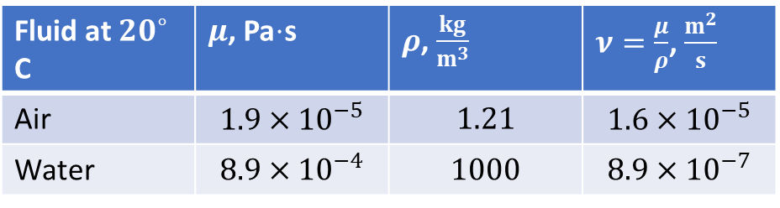
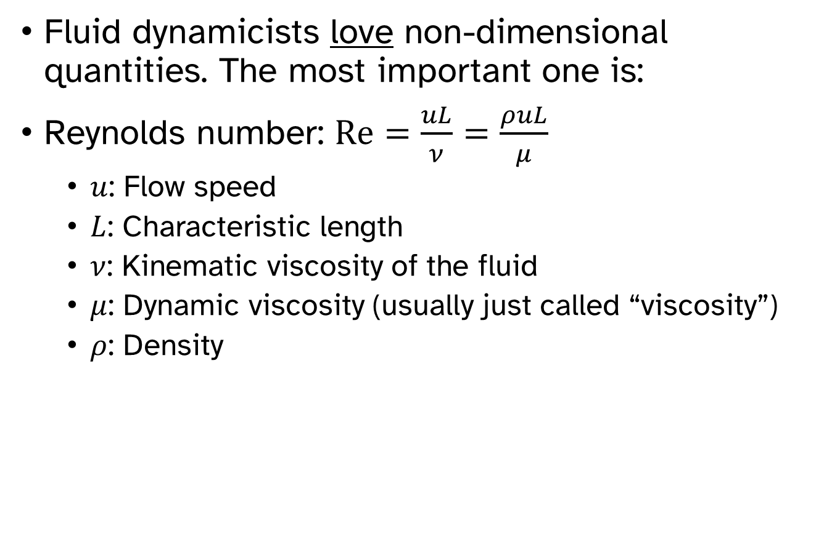
Non-dimensional quantities in fluid dynamics
Fluid dynamicists love non-dimensional quantities. The most important one is:
Reynolds number: $Re=\frac{uL}{ν}=\frac{ρuL}{μ}$
$u$: Flow speed
$L$: Characteristic length
$ν$: Kinematic viscosity of the fluid
$μ$: Dynamic viscosity (usually just called “viscosity”)
$ρ$: Density
Fluid at $20^{∘}$ C | $μ$, Pa$⋅$s | $ρ$, $\frac{kg}{m^{3}}$ | $ν=\frac{μ}{ρ}$, $\frac{m^{2}}{s}$
Air | $$1.9×{10}^{−5}$$ | $$1.21$$ | $$1.6×{10}^{−5}$$
Water | $$8.9×{10}^{−4}$$ | $$1000$$ | $$8.9×{10}^{−7}$$

Slide 20
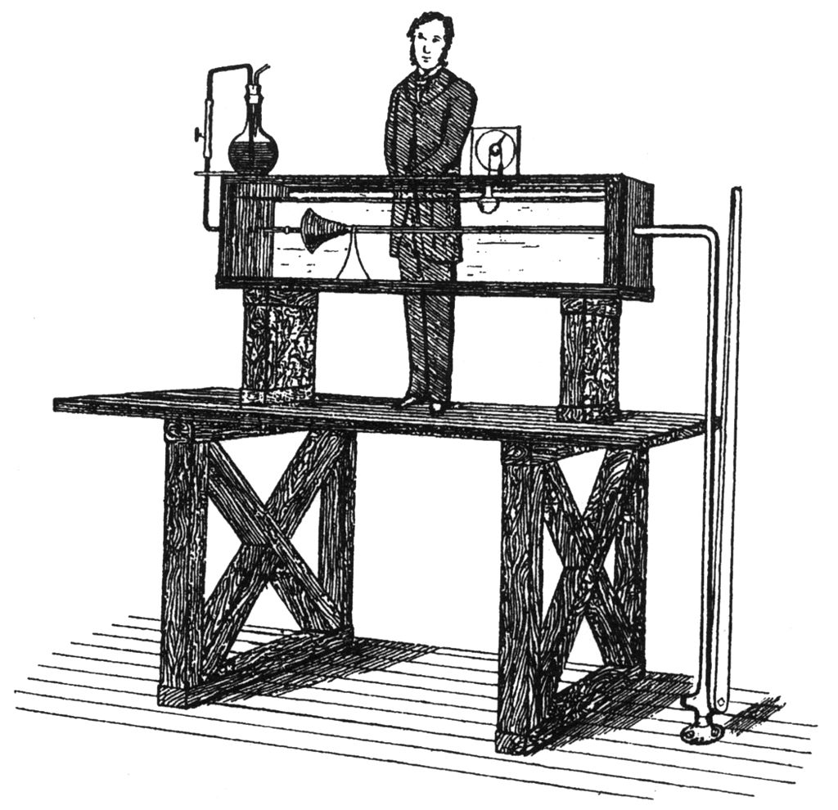
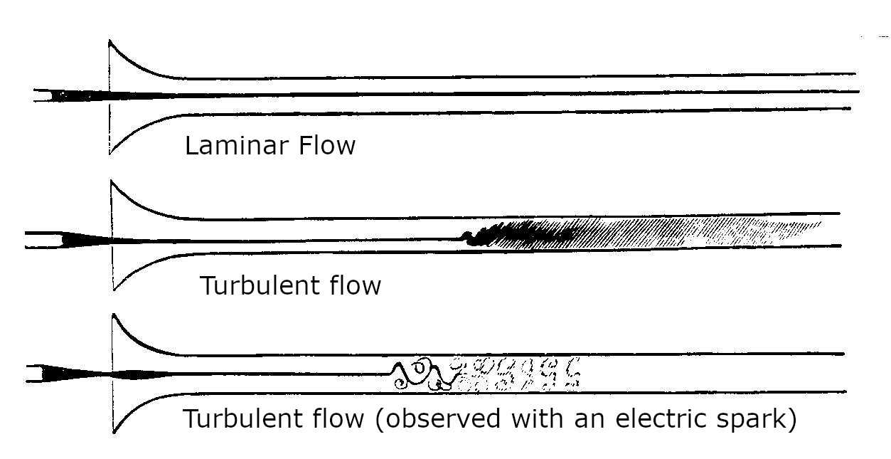
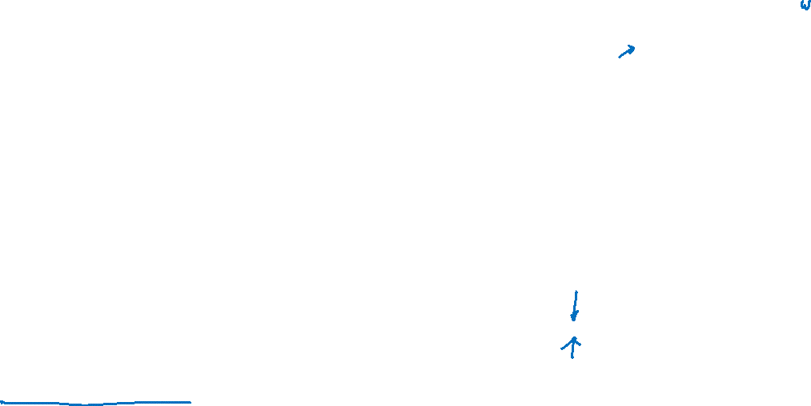
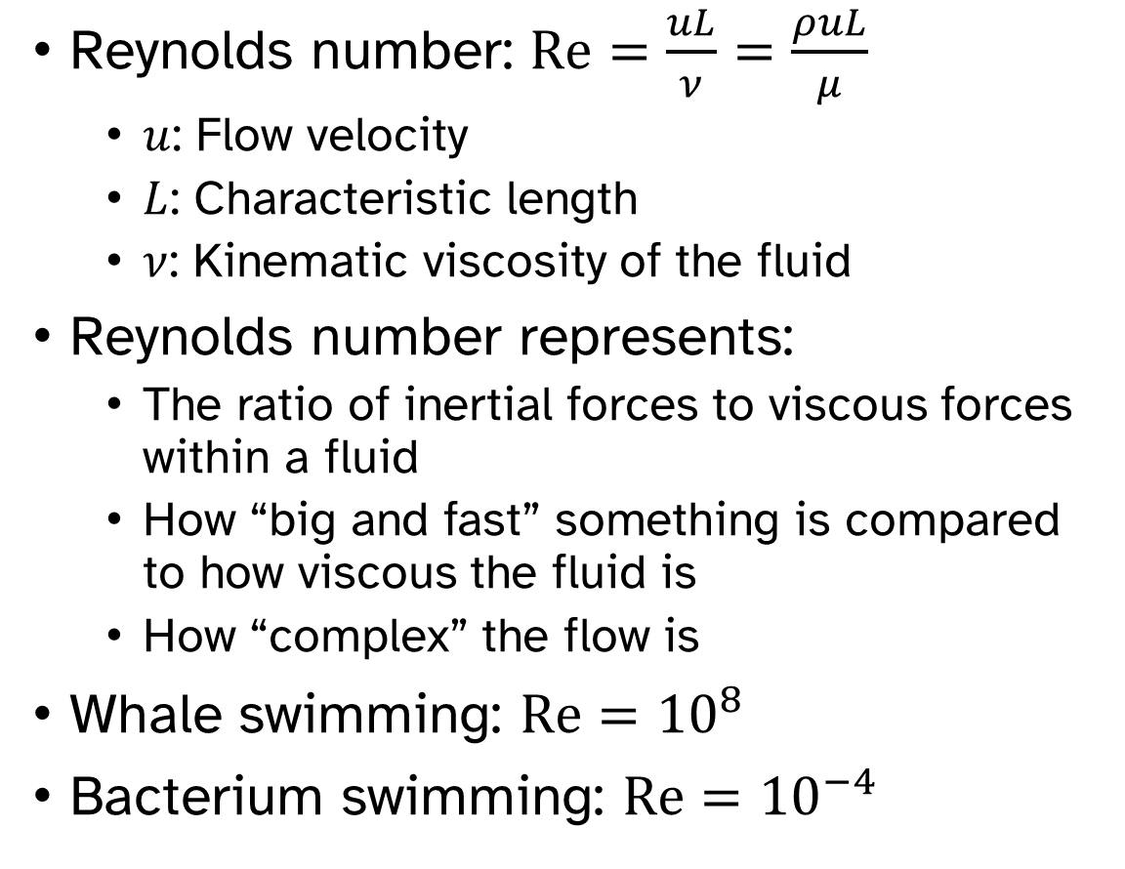
Non-dimensional quantities in fluid dynamics
Osborne Reynolds
Reynolds number: $Re=\frac{uL}{ν}=\frac{ρuL}{μ}$
$u$: Flow velocity
$L$: Characteristic length
$ν$: Kinematic viscosity of the fluid
Reynolds number represents:
The ratio of inertial forces to viscous forces within a fluid
How “big and fast” something is compared to how viscous the fluid is
How “complex” the flow is
Whale swimming: $Re={10}^{8}$
Bacterium swimming: $Re={10}^{−4}$
Low Re
High Re

Slide 21
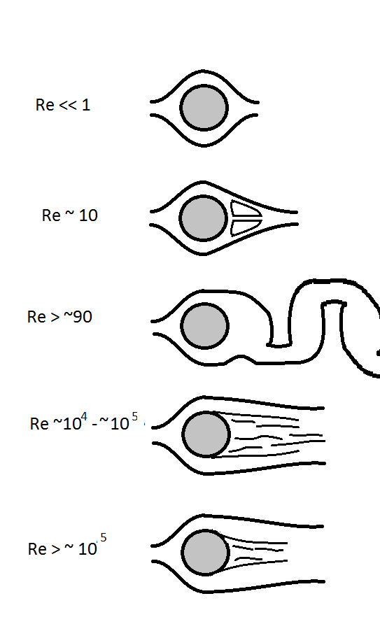
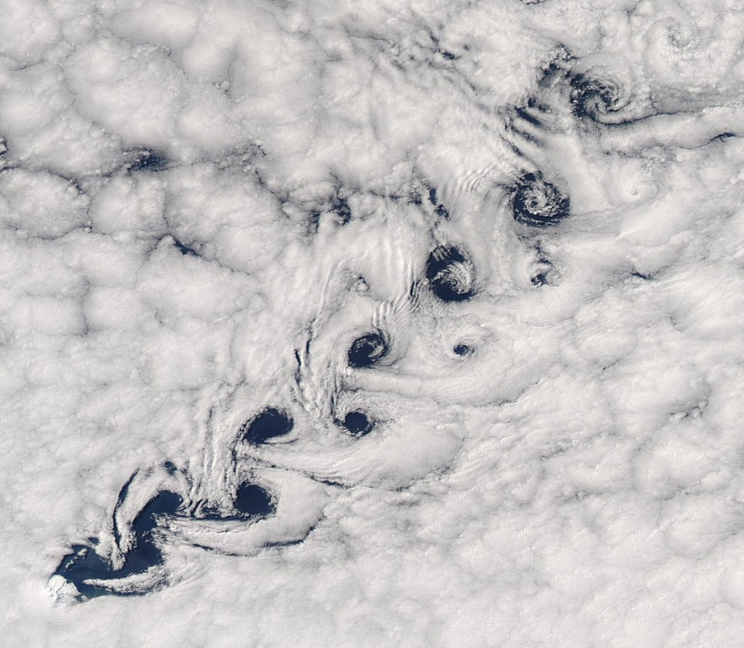
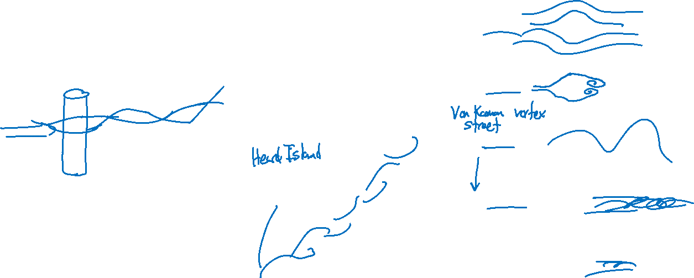
Vortex shedding
For a cylinder in a cross-flow, the Reynolds number determines what happens to the downstream flow:
For a wide range of Reynolds numbers, vortex shedding occurs.
Cesareo de La Rosa Siqueira
By Teapeat - Own work, CC BY-SA 3.0, https://commons.wikimedia.org/w/index.php?curid=23285699

Slide 22
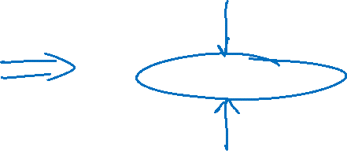
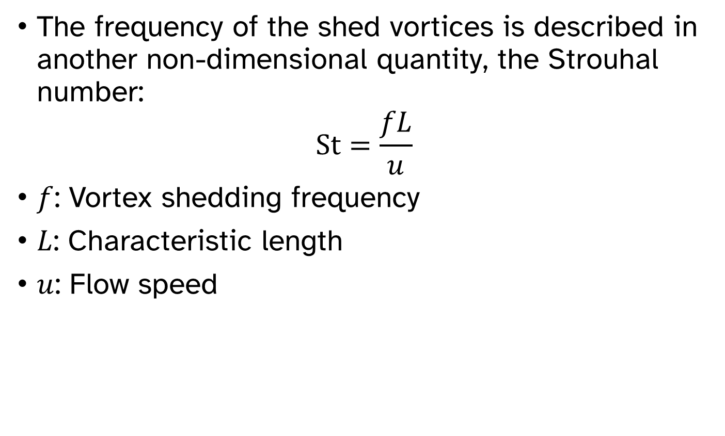
Vortex shedding
The frequency of the shed vortices is described in another non-dimensional quantity, the Strouhal number:
$$St=\frac{fL}{u}$$
$f$: Vortex shedding frequency
$L$: Characteristic length
$u$: Flow speed
Cesareo de La Rosa Siqueira

Slide 23
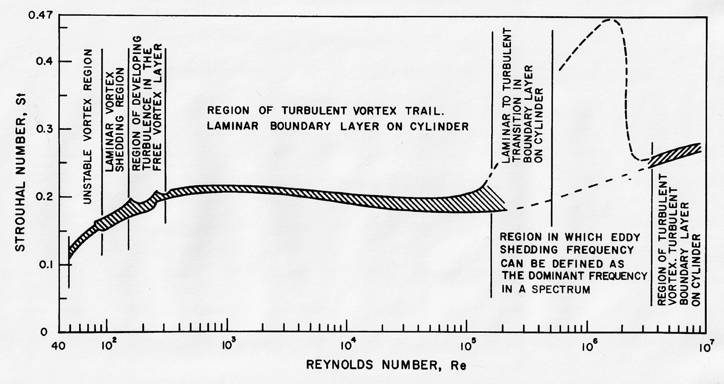
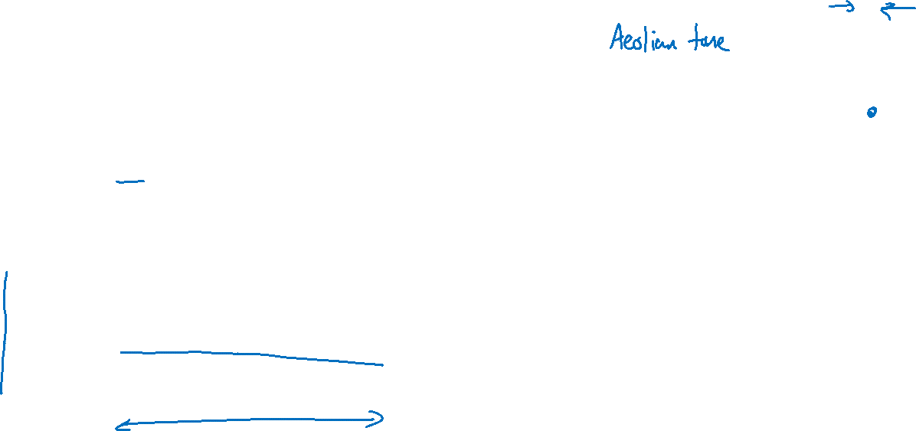

Vortex shedding
The Strouhal number is fairly constant across a very wide range of Reynolds numbers
$St=\frac{fL}{u}≈0.2$ for cylinders for many flow conditions
Cesareo de La Rosa Siqueira

Slide 24
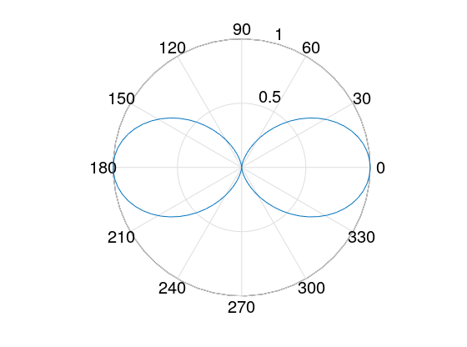

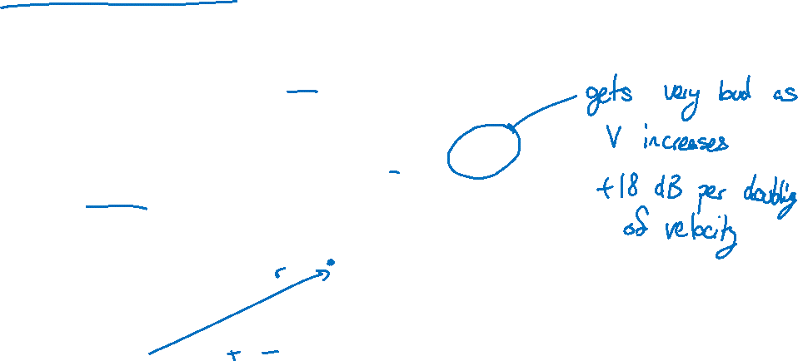
Vortex shedding
For a cylinder of length $l$ and diameter $d$, with flow velocity $V$, the shedding frequency is
$$f=0.2\frac{V}{d}$$
This produces a dipole-like source:
$$p_{rms}^{2}≈0.27\cos^{2}{θ}\frac{ρ^{2}ld{St}^{2}}{c^{2}}\frac{V^{6}}{r^{2}}$$
Cesareo de La Rosa Siqueira

Slide 25
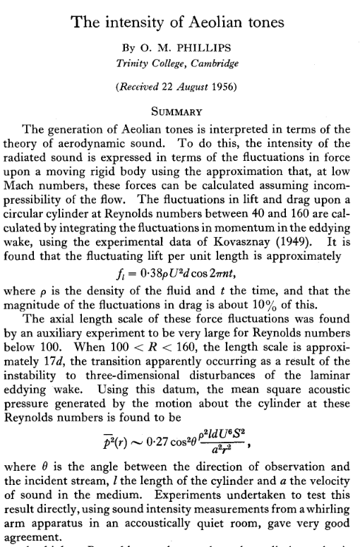
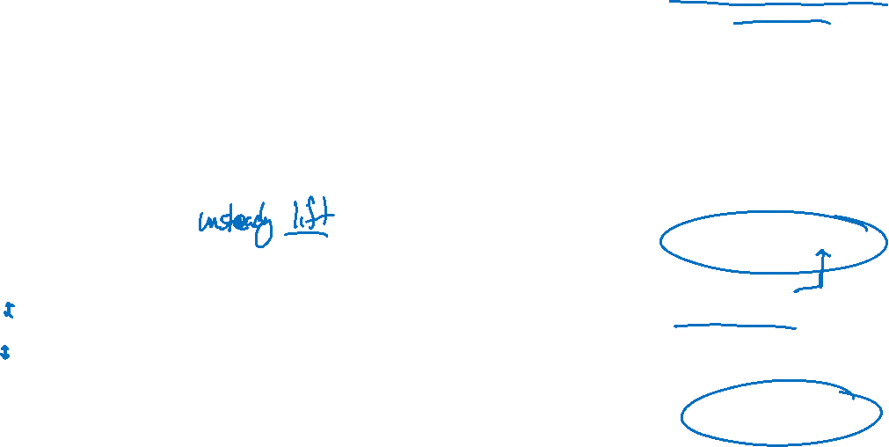
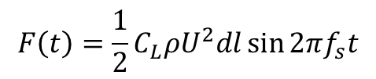
Vortex-induced vibration
The shed vortices also produce oscillating lift on the cylinder.
$$F\left(t\right)=\frac{1}{2}C_{L}ρU^{2}dl\sin{2πf_{s}t}$$
Cesareo de La Rosa Siqueira

Slide 26
Vortex-induced vibration
https://www.youtube.com/watch?v=Eh_vOcXazaU

Slide 27
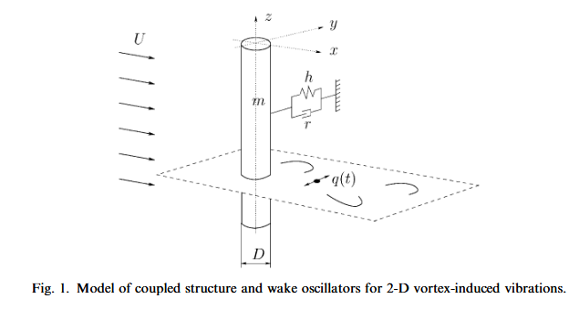
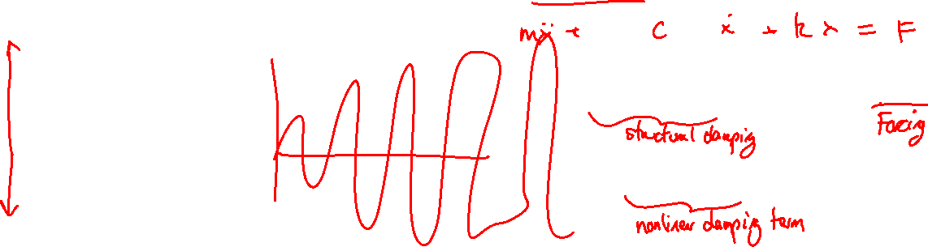
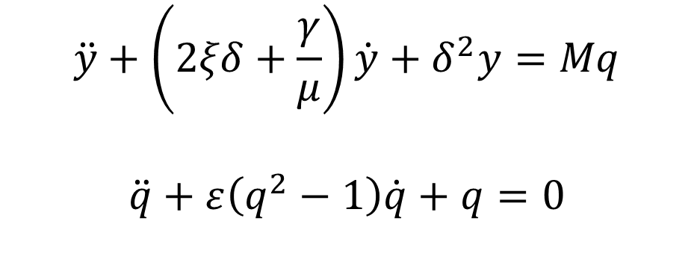
Vortex-induced vibration
Just like friction-induced vibrations, there is a competition between:
The energy the fluid adds to the structure
The energy the damping removes from the structure
If the structure cannot dissipate all of the energy, large oscillations can occur.
M.L. Facchinetti et al. / Journal of Fluids and Structures 19 (2004) 123–140
$$\ddot{y}+\left(2ξδ+\frac{γ}{μ}\right)\dot{y}+δ^{2}y=Mq$$
$$\ddot{q}+ε\left(q^{2}−1\right)\dot{q}+q=0$$

Slide 28
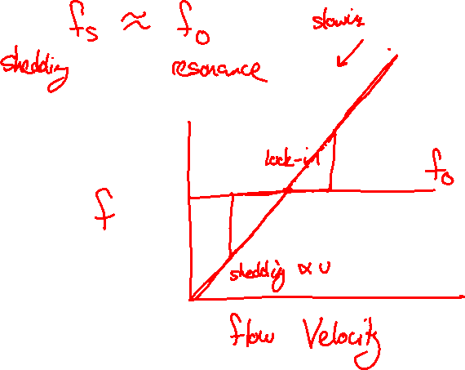
Vortex-induced vibration and lock-in
Lock-in is a high-amplitude vibration that can occur when the vortex shedding frequency is close to the resonance frequency. The shedding frequency “locks-in” to the resonance frequency and tends to stay there, even if the flow speed is changed.
Lock-in occurs because the system cannot dissipate energy fast enough at low amplitudes. The oscillations grow until:
There is enough drag on the body to dissipate the energy, or
Something breaks

Slide 29



Reducing vortex shedding and lock-in
$$p_{rms}^{2}≈0.27\cos^{2}{θ}\frac{ρ^{2}ld{St}^{2}}{c^{2}}\frac{V^{6}}{r^{2}}$$
Shedding will be louder if the cylinder is longer
Make the cylinder function as multiple shorter cylinders by adding strakes
Coherent length: distance over which sources are coherent
By StromBer - Own work, CC BY-SA 3.0, https://commons.wikimedia.org/w/index.php?curid=14871163

Slide 30


Reducing vortex shedding and lock-in
Robert Blevins, Harris’ Shock and Vibration Handbook, 6th ed., Ch 30
By StromBer - Own work, CC BY-SA 3.0, https://commons.wikimedia.org/w/index.php?curid=14871163

Slide 31


Reducing vortex shedding and lock-in
Worse
Changing the shape of the trailing edge of a body in flow can significantly reduce the vortex shedding and lock-in risk.
Baseline
Better
W.K. Blake, “Excitation of Plates and Hydrofoils by Trailing Edge Flows,” J. Vib., Acs., Stress, and Reliability in Design, 1984.

Slide 32



Aeroelasticity and the Tacoma Narrows Bridge
For a 2-D shape, the fluid can cause pitching as well as lift
The twisting motion follows the equation:
$\ddot{θ}+2ζω_{0}\dot{θ}+ω_{0}^{2}θ=Aθ+B\dot{θ}$
$A$ and $B$ depend on the speed and geometry.
Negative damping occurs if $2ζω_{0}−B<0$
See videos at https://en.wikipedia.org/wiki/Tacoma_Narrows_Bridge_(1940)
Billah and Scanlan, Resonance, Tacoma Narrows bridge failure, and undergraduate physics textbooks, Am. J. Phys 59 (2), 1991

